Slide 1
Deep Dive: .NET Internals
Brandon Minnick
Code Traveler, LLC

Slide 2
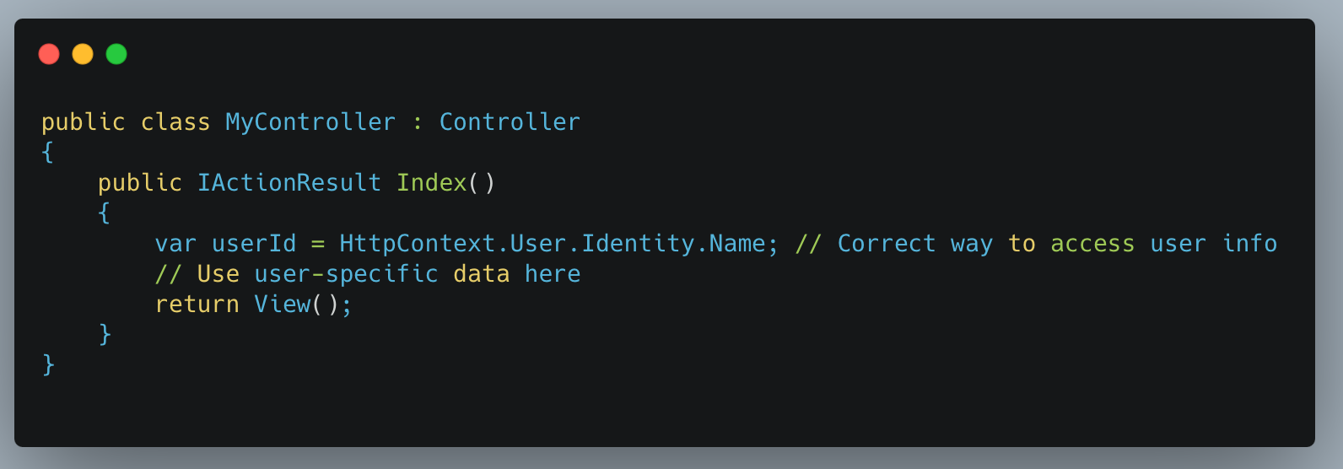
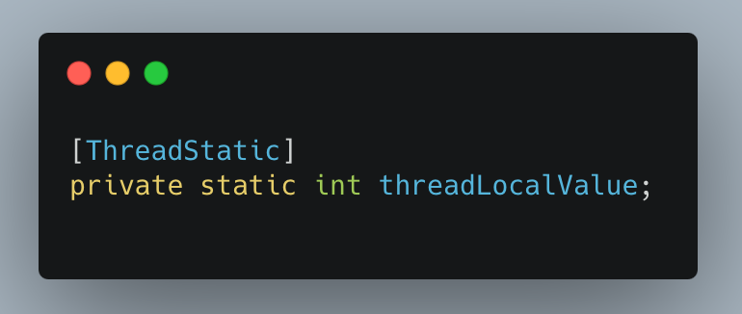
ThreadStatic [ThreadStatic]
Stores Thread-specific data
Allowed on static fields
Security Concerns
Data leaks caused by re-used Threads in ASP.NET Core
Tasks may continue on different threads
Use HttpContext instead
Notes:
https://github.com/dotnet/runtime/blob/main/src/libraries/System.Private.CoreLib/src/System/Threading/AsyncLocal.cs

Slide 3
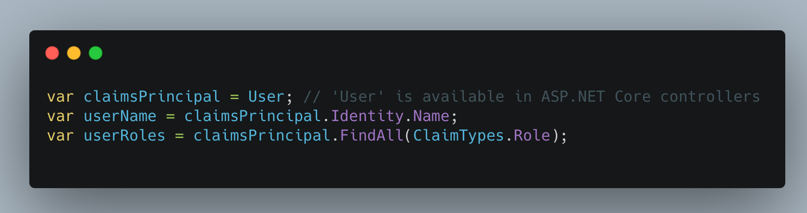
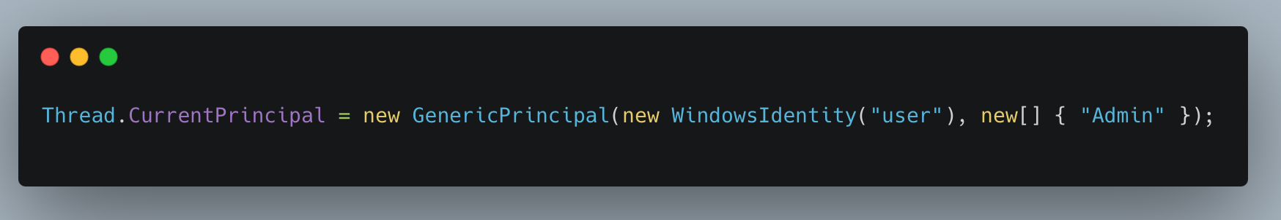
Security System.Security.Principal
Identity
Who is performing the action (e.g., the user’s identity).
Roles and Claims
What the user is allowed to do
Permissions
What specific actions or resources the user is authorized to access
Notes:
In .NET, there is no specific class called SecurityContext as part of the base class library, but security-related context management does exist through different mechanisms, often related to security principals, permissions, and authentication/authorization.
Here are some key concepts related to security context in .NET:
1. SecurityContext (in a conceptual sense)
While there isn’t a class specifically named SecurityContext, the term generally refers to the context that holds security-related information about the current execution. This includes:
Identity: Who is performing the action (e.g., the user’s identity).
Roles and Claims: What the user is allowed to do (e.g., roles or claims associated with the identity).
Permissions: What specific actions or resources the user is authorized to access.
2. System.Security.Principal
WindowsIdentity and GenericPrincipal represent the identity and the roles of the user currently executing.
The IPrincipal interface (implemented by GenericPrincipal) provides methods like IsInRole() to check the roles associated with the current user.
csharp
Copy code
IPrincipal principal = Thread.CurrentPrincipal; bool isAdmin = principal.IsInRole("Admin");
3. ExecutionContext and SecurityContext
In .NET, ExecutionContext encapsulates information like call context, security context, and more. The security-related aspects of ExecutionContext store things like the current security principal and permission sets.
The SecurityContext is a structure within ExecutionContext that helps manage security tokens like Windows user identities, and the AppDomain security for executing code.
You can manage the security context by using ExecutionContext.Run and ExecutionContext.SuppressFlow to control security flow across asynchronous calls.
For example:
csharp
Copy code
ExecutionContext.Run(executionContext, callback, state);
4. Thread.CurrentPrincipal
In multi-threaded applications, Thread.CurrentPrincipal holds the security context associated with the current thread (who the thread is running as, and what roles/permissions it has). This is typically set during the login/authentication phase and remains throughout the thread’s lifetime.
csharp
Copy code
Thread.CurrentPrincipal = new GenericPrincipal(new WindowsIdentity("user"), new[] { "Admin" });
5. WindowsIdentity and WindowsPrincipal
For applications running in Windows, you may encounter WindowsIdentity and WindowsPrincipal, which provide identity and role information based on Windows security.
csharp
Copy code
var identity = WindowsIdentity.GetCurrent(); var principal = new WindowsPrincipal(identity); bool isAdmin = principal.IsInRole(WindowsBuiltInRole.Administrator);
6. Claims-Based Identity (in ASP.NET Core and .NET Identity)
In modern .NET applications, especially in ASP.NET Core, the security context can be represented by a ClaimsPrincipal object. This contains the user's identity and associated claims, which represent information about the user, such as roles, permissions, or custom data.
csharp
Copy code
var claimsPrincipal = User; // 'User' is available in ASP.NET Core controllers var userName = claimsPrincipal.Identity.Name; var userRoles = claimsPrincipal.FindAll(ClaimTypes.Role);
Summary
While there is no specific class named SecurityContext in .NET, security information is managed through mechanisms like:
ExecutionContext (for flow of security context).
Thread.CurrentPrincipal (for thread-specific security).
IPrincipal/GenericPrincipal (for identity and role management).
ClaimsPrincipal (especially in ASP.NET Core).
These components handle security context and ensure that the correct identity and roles are applied during execution in a .NET application.

Slide 4
ExecutionContext All Information Required for a Logical Thread
Stores data specific to a Thread
Security information (impersonation)
Synchronization context
Culture information
Attached to Task
Loaded to the thread before execution
Immutable
Can be suppressed
`ExecutionContext.SupressFlow()` + `ExecutionContext.RestoreFlow()`
Notes:
https://medium.com/net-under-the-hood/hidden-workings-of-execution-context-in-net-43b491726c65
https://github.com/dotnet/runtime/blob/main/src/libraries/System.Private.CoreLib/src/System/Threading/ExecutionContext.cs
https://github.com/dotnet/runtime/blob/main/src/libraries/System.Private.CoreLib/src/System/Threading/Thread.cs

Slide 5
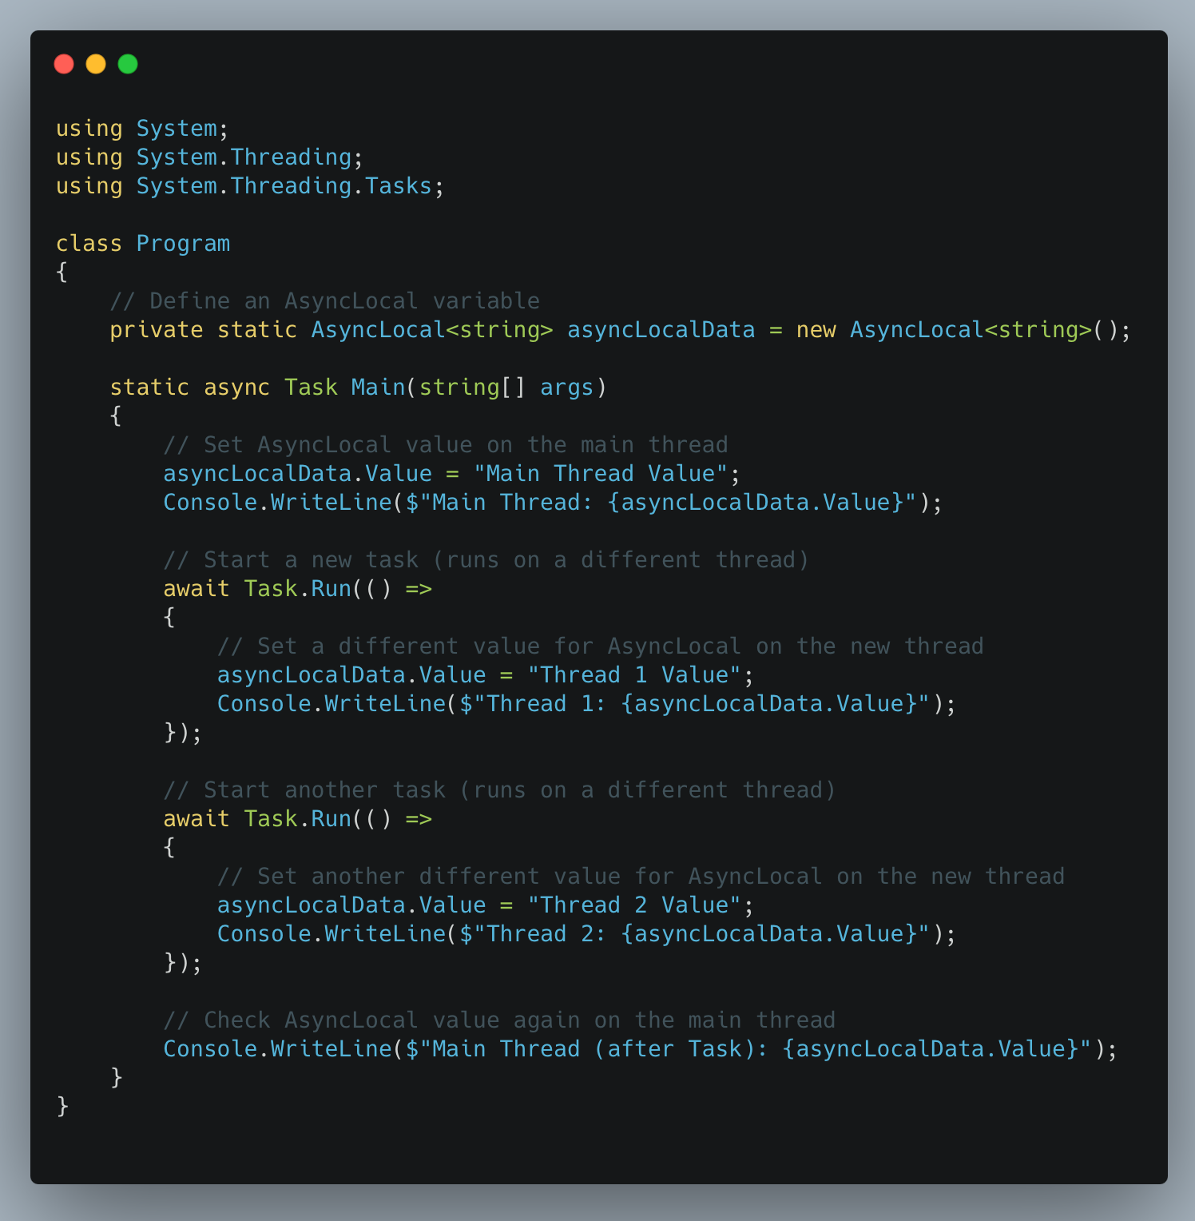
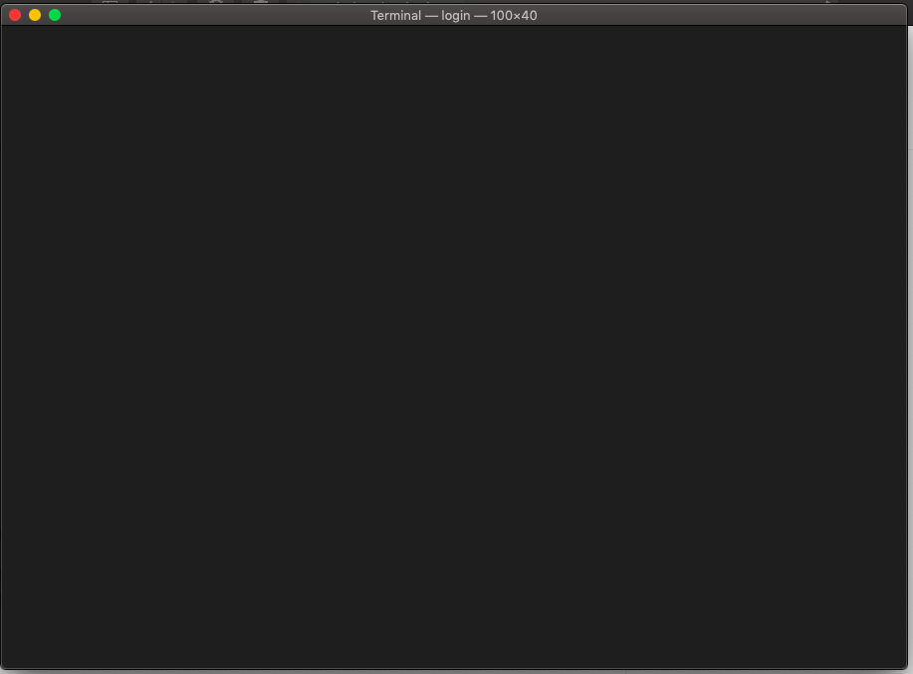
ExecutionContext AsyncLocal<T>
Stores Data Specific to the operation
Main Thread: Main Thread Value
Thread 1: Thread 1 Value
Thread 2: Thread 2 Value
Main Thread (after Task): Main Thread Value
Notes:
https://github.com/dotnet/runtime/blob/main/src/libraries/System.Private.CoreLib/src/System/Threading/AsyncLocal.cs

Slide 6
SynchronizationContext Manages Asynchronous Code Execution
Used in UI Frameworks*
Controls Task Continuations
Return to calling thread
When null, continuations use Thread Pool
Notes:
https://github.com/dotnet/runtime/blob/main/src/libraries/System.Private.CoreLib/src/System/Threading/SynchronizationContext.cs

Slide 7
SynchronizationContext *ASP.NET Core MVC
No SynchronizationContext in ASP.NET Core
UI Updates On Server
HTML Sent to Browser for Rendering
Notes:
In ASP.NET Core MVC, UI updates happen entirely on the server, and then the HTML is sent to the browser for rendering. The browser’s event loop and JavaScript interop come into play when you’re doing client-side interactivity, but ASP.NET Core MVC itself is a server-side rendering model that does not use JavaScript to update the UI directly.

Slide 8
SynchronizationContext *ASP.NET Core HttpContext
Contains Request / Response Information
Eg Request headers, Cookies, Session
Scoped to the HTTP Request
“Request-scoped services”
Retrieved via IHttpContextAccessor
Notes:
HttpContext: This represents the context for a single HTTP request. It contains all the information about the request and response, such as request headers, cookies, session, etc.
public class HomeController : Controller
{
private readonly IHttpContextAccessor _httpContextAccessor;
public HomeController(IHttpContextAccessor httpContextAccessor)
{
_httpContextAccessor = httpContextAccessor;
}
public async Task<IActionResult> Index()
{
// Accessing HttpContext before awaiting a task
var requestPathBefore = _httpContextAccessor.HttpContext.Request.Path;
// Simulate an async task (e.g., database call or external API call)
await Task.Delay(1000);
// Accessing HttpContext after the task completes
var requestPathAfter = _httpContextAccessor.HttpContext.Request.Path;
// The HttpContext is still accessible and hasn't been lost
Console.WriteLine($"Request Path before: {requestPathBefore}");
Console.WriteLine($"Request Path after: {requestPathAfter}");
return View();
}
}

Slide 9
SynchronizationContext *Blazor Server
No SynchronizationContext
UI Updates On Server
HTML Sent to Browser for Rendering
Client app connects to Server via SignalR
Bidirectional communication via WebSocket protocol
User events sent to server for processing
eg Button click
Notes:
Blazor Server Overview:
In Blazor Server, the UI rendering happens on the server side. The client (the web browser) only handles the display of the UI, but all logic and rendering are executed on the server. Here's how it works:
SignalR Connection: When a user connects to a Blazor Server app, the client establishes a SignalR connection to the server. SignalR is a real-time communication framework in .NET that enables bi-directional communication between the server and client over a persistent connection.
Event Handling: When the user interacts with the UI (e.g., clicks a button, changes a form value, etc.), the event is sent to the server via the SignalR connection. The server processes the event (it could be an asynchronous task, such as fetching data from a database), updates the component's state, and schedules a re-render of the component.
Component Re-rendering: After processing the event on the server, Blazor triggers a re-render of the affected component(s). The updated UI is then sent to the client over the SignalR connection as a diff (only the parts of the DOM that have changed are sent), and the client applies the changes to the DOM.
DOM Updates: The browser receives the updated UI (a diff of HTML), and Blazor applies the changes directly to the DOM. This is a key feature of Blazor’s rendering process—it minimizes the amount of data transferred between the server and client by only sending the differences (diffs) rather than re-sending the entire HTML for the page.
Key Points in the Blazor Server Render Loop:
No JavaScript Interop for Rendering:
Unlike Blazor WebAssembly, which runs entirely in the browser and interacts with JavaScript to manipulate the DOM directly, Blazor Server does not need JavaScript interop for updating the render loop. The entire rendering process is driven by the server.
The client does not directly manipulate the DOM; instead, it receives changes from the server via SignalR and applies them to the DOM.
SignalR-Driven Updates:
SignalR handles all real-time communication between the client and the server. When an event occurs (like a button click), the server processes the event, and the component is marked for re-render. The SignalR connection ensures that the updated state is communicated to the client, and only the differences (diffs) in the rendered HTML are sent back to the browser for rendering.
Rendering Cycle:
The Blazor Server rendering cycle works as follows:
UI Event (e.g., button click or form submit) is captured by the client.
The event is sent to the server over SignalR.
The server processes the event, updates the component state (potentially asynchronously), and triggers a re-render.
The server computes the diff between the old and new UI.
The diff is sent to the client over SignalR.
The client applies the diff to the DOM, updating the UI.
This loop does not require JavaScript interop because all communication between the client and server happens through SignalR and the server manages the rendering.

Slide 10
SynchronizationContext *Blazor WebAssembly
No SynchronizationContext
UI updates via Browser’s Event Loop
UI Components (.razor) each rendered independently
Batches UI updates on the Render Queue
Notes:
How Blazor Renders the UI Without a SynchronizationContext:
Blazor is able to render a UI without relying on a traditional SynchronizationContext because its rendering model is based on component-based architecture and uses a render loop. Both Blazor Server and Blazor WebAssembly leverage this loop to efficiently update the UI in response to state changes, typically driven by UI events (like clicks, form input, etc.) or asynchronous tasks (like data fetching).
The key components that allow Blazor to render the UI without a SynchronizationContext are:
UI Rendering Model:
Blazor uses a component-based model where each UI component (@code blocks) is rendered independently, and the UI state is updated in response to events. Whenever a component's state changes (through user interactions, data updates, or other events), Blazor triggers a re-render of that component.
Blazor WebAssembly: In Blazor WebAssembly, the rendering happens directly in the browser on the UI thread, and asynchronous operations (such as fetching data) are handled in the background without needing thread marshaling. This is because Blazor WebAssembly uses JavaScript interop and can update the UI using the browser's event loop, not needing a SynchronizationContext to marshal operations onto the UI thread.
Render Queue:
Blazor uses a render queue to manage the updates to the UI. Instead of marshaling the continuation of asynchronous operations back to a UI thread, Blazor schedules UI updates in this queue and then applies them as part of its rendering cycle. When an event occurs (like a user clicking a button or completing an async operation), Blazor marks the component for a re-render, and the UI is updated when the render queue is processed.
UI Updates and Asynchronous Operations:
In both Blazor Server and Blazor WebAssembly, asynchronous code (e.g., awaiting HTTP requests, timers, etc.) doesn't need a SynchronizationContext to update the UI. Instead, the framework is responsible for queuing the UI changes, and when the asynchronous operation completes, it triggers a re-render.
In Blazor Server (where the application runs on the server and the UI is rendered on the client), UI updates happen as a result of a SignalR connection. The SignalR connection enables the server to push updates to the client. When an event occurs on the client (like a button click), it is sent to the server, where the component is re-rendered on the server side, and the updated UI is sent back to the client via SignalR. This happens asynchronously, but the framework manages the UI updates.

